Slide 1
Domain Name System (DNS)
June 2015

Slide 2
Agenda
I. Introduction
II. Important DNS terminology:
IV. Advanced features
V. Tools
VI. Demo
VII. ALU DNS 6.0
VIII. References

Slide 3
Introduction
Using a host name is preferred when communicating over a network. Easily remembered than an IP address
Before 1982, HOSTS.TXT is used to map names to numerical addresses and each computer retrieved this file a computer at SRI
The rapid growth of the network made a centrally maintained, hand-crafted HOSTS.TXT unsustainable
A more scalable system is needed so Domain Name System (DNS) was invented in 1983

Slide 4
Introduction
DNS is a hierarchical distributed naming system for computers, services, or any resource connected to the Internet or a private network
Resolves queries for domain names into IP addresses.
An essential component of the functionality of the Internet.
The DNS protocol defines a set of messages sent over either User Datagram Protocol (UDP) port 53 or Transmission Control Protocol (TCP) port 53.

Slide 5
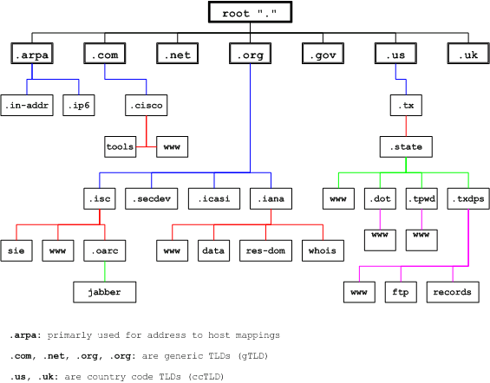
Introduction
The DNS namespace is based on a hierarchical and logical tree structure.

Slide 6
Important DNS terminology
Domain namespace, Domain name, Domain and subdomain
Domain namespace is the structure of the DNS database. A domain namespace that will contain a "tree" of domain names.
Domain name: Each node in the tree has a private label. An empty label representing the root. A full domain name of any node in the "tree" is the order of the labels in the path from that node to the root.
A domain is a branch of the namespace. The domain is the set of nodes that have the same parent node, this node creates a domain.
Domains can be further partitioned at node points within the domain into subdomains for the purposes of administration or load balancing.

Slide 7
Important DNS terminology
Domain com.au
The ausregistry.com.au sub-domain of com.au

Slide 8
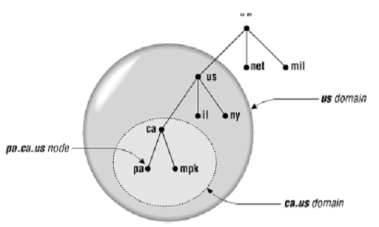
Important DNS terminology
TLD (Top level domain): child of root
The top of the hierarchy is served by the root nameservers, the servers to query when looking up (resolving) a TLD.
Us, vn are ccTLDs (country code TLD)
Mil, net are gTLDs (Generic TLD)

Slide 9
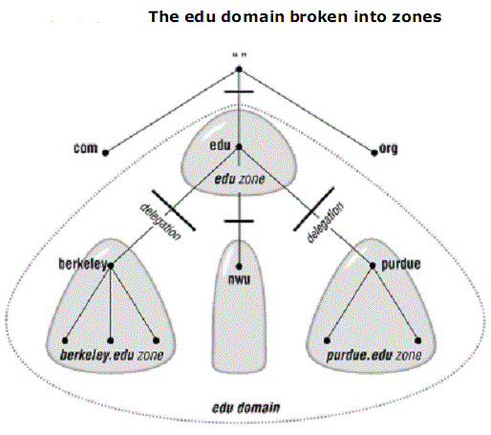
Important DNS terminology
Name Server
Name server: The programs that store information about the domain name space.
Name servers generally have complete information a zone, which they load from a file or from another name server.
The name server is then said to have authority for that zone
The name server is then said to have authority for that zone

Slide 10
Important DNS terminology
Name Server
DNS defines two types of name servers:
Primary name server: is the primary DNS server, which contains all the information for domain, allowed to add, delete, edit your DNS DATABASE
Secondary name server: is the DNS server, backup, DATABASE of the Primary again. Not change the DNS DATABASE. In case the Primary name server is fail, the Secondary is used for name resolution
There is also a Caching-only servers are DNS servers that only perform queries, cache the answers, and return the results.

Slide 11
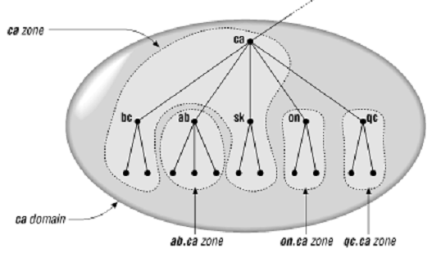
Important DNS terminology
Domain name and zone
Zone and domain can share the domain name (ca) but contain different node
Domain name ca contains all data in ca + all data in ab.ca, on.ca and qc.ca
Zone ca only contains all data in ca

Slide 12
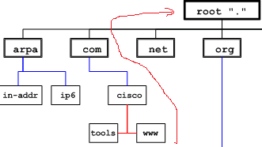
Important DNS terminology
Fully Qualified Domain Name (FQDN)
A fully qualified domain name (FQDN) is a DNS domain name that has been constructed from its location relative to the root of the namespace (known as the root domain).
FQDN: www.cisco.com.”

Slide 13
Important DNS terminology
Types of Queries
Recursive queries:
“.” root NS
2
8
3
Local NS
9
1
www.tma.com.vn
Vn. ns
10
4
www.tma.com.vn A IN 221.133.0.1
7
com.vn. ns
5
6
Tma.com.vn. ns

Slide 14
Important DNS terminology
Types of Queries
“.” root NS
Iterative queries:
4 ask vn
3
6 ask com.vn
1
Vn. ns
www.tma.com.vn
Local NS
2 ask root
5
9 www.tma.com.vn IN A 221.133.0.1
8 ask tma.com.vn
7
8
com.vn. ns
Tma.com.vn. ns

Slide 15
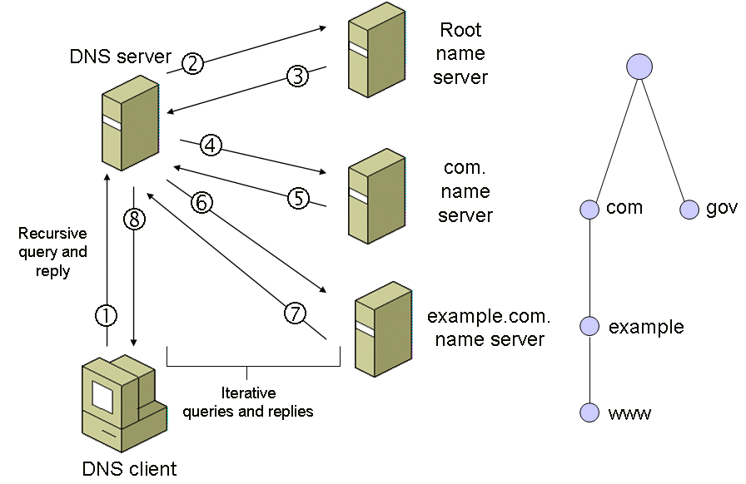
Important DNS terminology
Types of Queries
Real deployment:
- Queries between Resolver---> DNS Server is the recursive query
- Queries between DNS Server > DNS Server---is interactive query

Slide 16
Important DNS terminology
Caching
DNS Server and Client will save these queries (caching) to be the next time it will search in the cache before If queries have in the cache it will answer immediately without further queries. This helps for faster operations network (performing).

Slide 17
Important DNS terminology
Resource Record
A domain contains resource records
Resource records are analogous to files
Classified into types
Some of the important types are SOA, NS, A, AAAA*, CNAME and MX
Normally defines in “zone files”

Slide 18
Important DNS terminology
SOA Records
The SOA record indicates that this name server is the best source of information for the data within this zone.
There can be one, and only one, SOA record in a zone data file.
Eg. The record:
domain-name IN SOA mname rname (
serial refresh retry expire minimum time-to-live)
movie.edu. IN SOA terminator.movie.edu. al.robocop.movie.edu.(
1 ; Serial
3h ; Refresh after 3 hours
1h ; Retry after 1 hour
1w ; Expire after 1 week
1h ) ; Negative caching TTL of 1 day

Slide 19
Important DNS terminology
SOA Records
domain-name: domain name of this zone
mname: domain name of the name server that was the original or primary (master) source of data for this zone.
rname: the mailbox of the person responsible for this zone (a "." is used instead of an "@“)
serial: version number of the original copy of the zone. Zone transfers preserve this value
refresh: the time (in seconds) a secondary DNS server waits before querying the primary DNS server's SOA record to check for changes and request a zone transfer
retry: the time (in seconds) a secondary server waits before retrying a failed zone transfer
expire: the time (in seconds) that a secondary server will keep trying to complete a zone transfer, if this time expires prior to a successful zone transfer, the secondary server will expire its zone file (i.e., it will stop answering queries)
minimum time-to-live: The Minimum Time to Live is the number of seconds an external caching

Slide 20
Important DNS terminology
NS Records (Name Server Records)
Indicates the servers that are authoritative for a zone.
NS records indicate primary and secondary servers for the zone specified in the SOA resource record, and they indicate the servers for any delegated zones.
Every zone must contain at least one NS record at the zone root.
Eg. The record:
movie.edu. IN NS terminator.movie.edu.
movie.edu. IN NS wormhole.movie.edu.

Slide 21
Important DNS terminology
A Records (Address Records)
Maps an FQDN to an IPv4 address.
example.com. A 192.0.2.1 ;IPv4 address for example.com ns.example.com. A 192.0.2.2 ;IPv4 address for ns.example.com
AAAA
Maps an FQDN to an IPv6 address
PTR (Pointer)
Maps an IP address to an FQDN for reverse lookups.
1.249.249.192.in-addr.arpa. IN PTR wormhole.movie.edu. 2.249.249.192.in-addr.arpa. IN PTR robocop.movie.edu.

Slide 22
Important DNS terminology
CNAME Records
A CNAME defines an alias
The alias will then be resolved, if another CNAME is encountered then the process continues until an A record is found.
Eg. The record: www.example.com is an alias for example.com
www.example.com. CNAME example.com.
MX Records ( Mail Exchange Records)
An MX record defines the mail servers for a particular domain
Eg. The record:
ausregistry.com.au MX 10 mail
In the ausregistry.com.au domain, defines the host mail to be the priority 10 mail server for the “ausregistry.com.au” domain

Slide 23
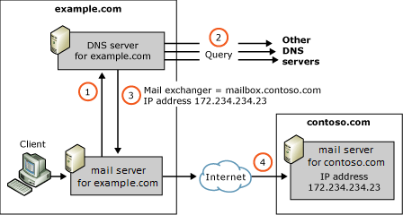
Important DNS terminology
MX Records ( Mail Exchange Records)

